Slide 1
L3 Security
EN.600.444/644
Spring 2019
Dr. Seth James Nielson

Slide 2
IPv4 Protocol
Layer 3 Protocol
Handles fragmentation and reassembly
Assumed that across multiple LANS, multiple MAC protocols
Each MAC protocol might have its own MTU
Also, of course, includes the global IP address
Kind of global…

Slide 3
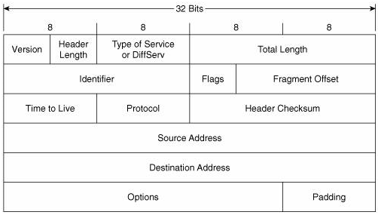
IPV4 Header

Slide 4
IPv4 Header FIELDS
Version – 0100 (binary 4)
Header Length – Length of header in 4-byte increments
Total Length – Size of header and data in bytes (max 65535)
Identification – for recognizing fragments
Flags
Reserved. Always 0
Don’t fragment
More fragments

Slide 5
More IPV4 Header Fields
Fragment Offset – Offset in original datagram
TTL – Counter to prevent infinite routing
Protocol – Information about upper layer (17=UDP, 6=TCP)
Header Checksum
Recomputed each hop (because of TTL changes)
Checksum field itself always presumed to be 0

Slide 6
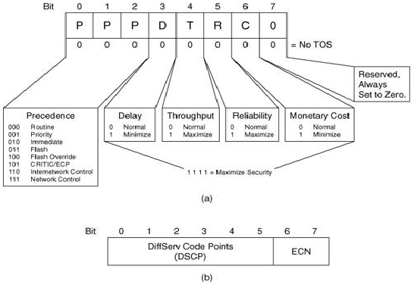
Original ToS

Slide 7
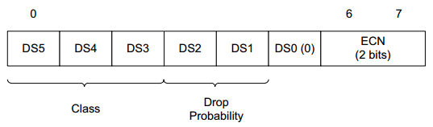
Differentiated Services

Slide 8
ECN
Explicit Congestion Notification
When enabled, indicates congestion without dropping
Not all hardware/software supports ECN

Slide 9
IPV4 Addresses
IPv4 Addresses are a.b.c.d where each is between 0-255
In actuality, just a 32-bit number (“four octets”)
192.0.2.235
3221226219
0xC00002EB (0xC0.0x00.0x02.0xEB)
Private Networks:
10.0.0.0
172.16.0.0
192.168.0.0

Slide 10
Fragmentation
If packet size > MTU, and DNF is 0
Each fragment gets its own size
Each fragment except the last gets MF set to 1
Fragment offset is location in the original packet
Identification field is unique identifier of original datagram
Reassembly
Use src, dst, protocol, and identification to identify fragments
Use offset to store data in reassembly buffer
Use MF = 0 to recognize end of reassembly

Slide 11
Fragmentation Issues
IPv4 Fragmentation had security issues
IP Fragmentation Overlap (overwrite a fragment)
Buffer full (too many incomplete fragments)
Fragment overrun
(Note that most of these are DoS, but some evasion)

Slide 12
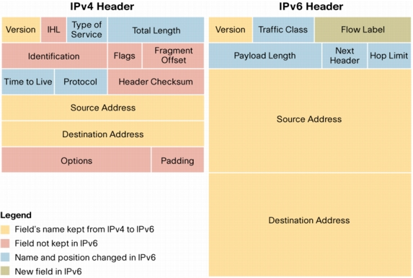
IPv6

Slide 13
IPV6 Header Fields
Version = 0110 (binary 6)
Traffic Class: Differentiated services plus ECN
Flow label: Hint for multiple outbound paths
Payload length: Includes extension headers, in bytes
Next header: Type of next extension or transport header
Hop limit: Decrement by 1, discard if 0

Slide 14
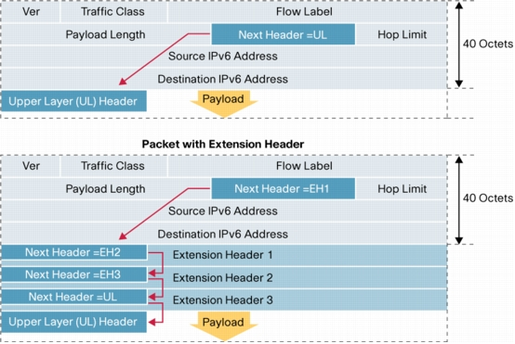
Extension Headers
IPv6 is always 40 bytes for main header
Can have additional headers:

Slide 15
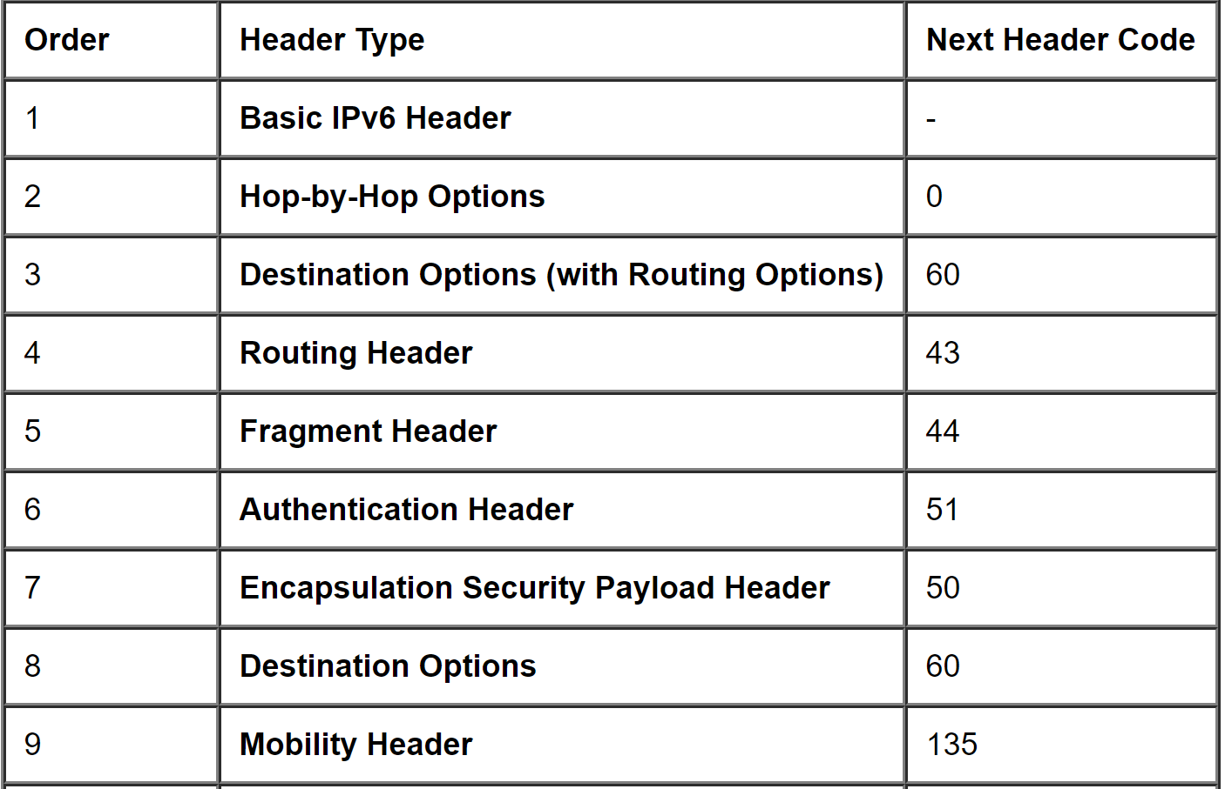
Common Extension Headers

Slide 16
IPV6 Fragmentation
To deal with IPv4 Frag issues, ONLY SENDER can frag in IPv6
Ergo, sender must know smallest MTU of path!
Path MTU Discovery (PMTUD)
If too big, send an ICMPv6 “packet too big” to sender
Otherwise, max IPv6 packet size is 1,280 bytes.
Uses a fragmentation extension header
Identification
MF, etc

Slide 17
IPv6 Frag Problems
Studies from 2014-present indicate IPv6 fragmentation fails
About one-third of IPv6 hosts could not receive frags
Many are concluding that IPv6 fragmentation is deprecated
Maximum IPv6 packet size between 1280 and 1350
See,
https://blog.apnic.net/2016/05/19/fragmenting-ipv6/
https://labs.apnic.net/?p=1033

Slide 18
IPSec
IPSec provides the following protocols:
Authentication Headers – integrity of immutable fields
Encapsulating Security Payloads – confidentiality
Security Associations – negotiate parameters of AH, ESP
Internet Key Exchange (IKE)

Slide 19
AH Fields
Operates ON TOP of IP!
Protocol Number 51
Next Header (e.g., TCP)
Payload Length – 4-octet units minus 2
Security Parameters Index – With dest address forms SA
Sequence Number – increasing number to prevent replay
Integrity Check Value – the authenticated hash

Slide 20
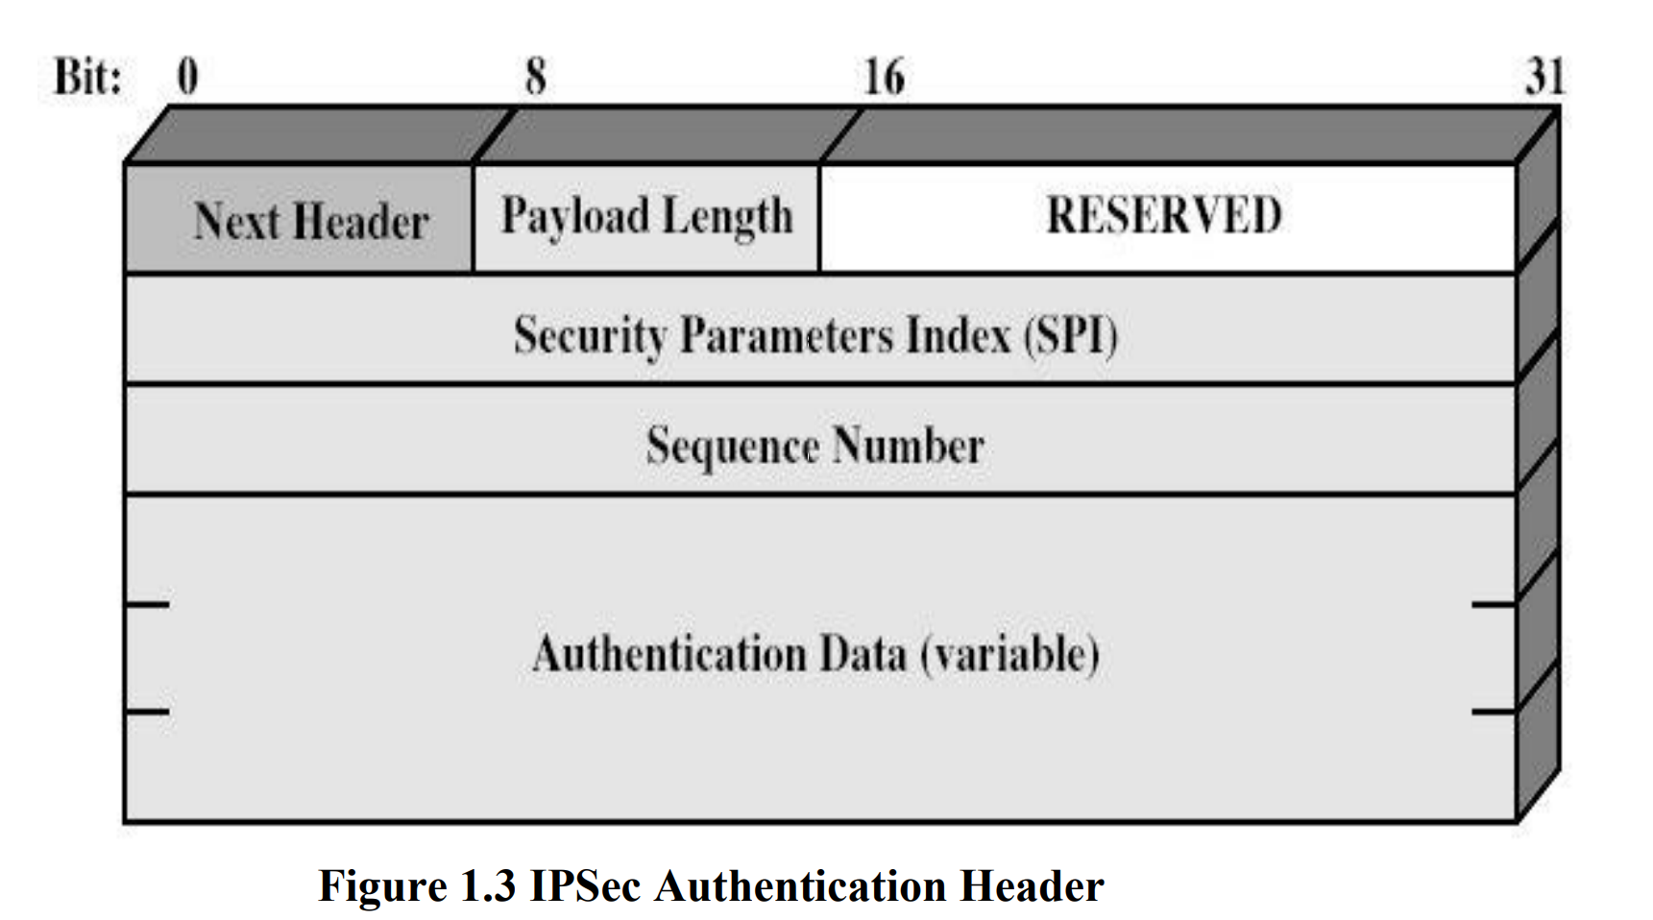
AH visual

Slide 21
ESP Fields
Operates on top of IP, protocol number 50
Security Parameter Index – With dest addr, identifies the SA
Sequence Number – Increasing number to prevent replay
Protected content of the original IP packet
Padding for encryption
Pad Length – Size of pad in octets
Next Header (e.g., TCP)
Integrity Check Value – authenticated hash

Slide 22
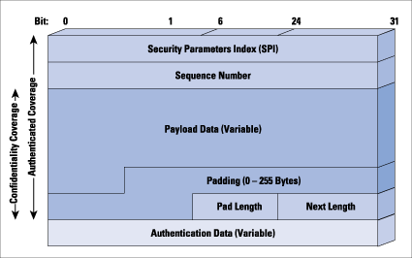
ESP Visual

Slide 23
IKE
Internet Key Exchange
IKEv1 (RFC 2409 + many updates)
IKEv2 (RFC 4306 + many updates)
Most recent version is 7296, updated by 7427, 7670, 8247

Slide 24
IKEv1
RFC 2409
Contains three protocols:
ISAKMP provides a framework for authentication and key exchange but does not define them
Oakley describes a series of key exchanges
SKEME describes a versatile key exchange technique which provides anonymity, repudiability, and quick key refreshment.
Uses part of Oakley and part of SKEME in conjunction with ISAKMP to obtain authenticated keying material

Slide 25
IKEv1 Protocol Phases
Phase 1 - where the two ISAKMP peers establish a secure, authenticated channel with which to communicate. This is called the ISAKMP Security Association (SA)
Phase 2 - Phase 2 is where Security Associations are negotiated on behalf of services such as IPsec or any other service which needs key material and/or parameter negotiation.
One phase 1 can permit many phase 2’s

Slide 26
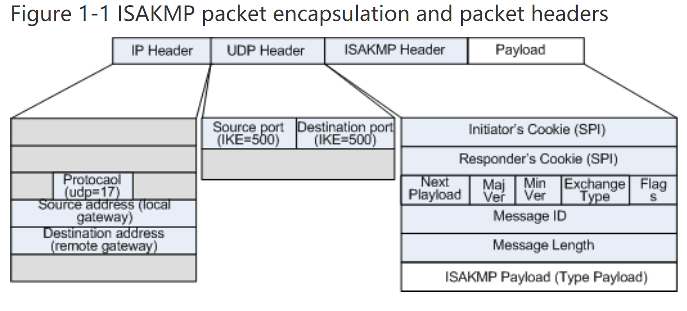
ISEKMP

Slide 27
ISAKMP Header
Initiator Cookie – Cookie of initiating device
Responder’s Cookie – Must be 0 on first message!
Next Payload – Indicates ISAKMP payload (examples:)
Security Association
Proposal
Transform
Exchange Type (phase 1, phase 2)

Slide 28
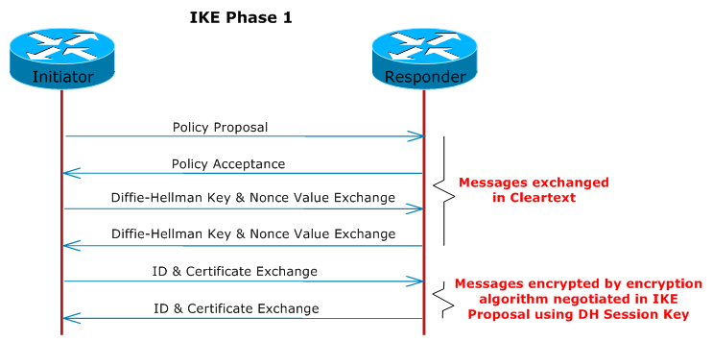
ISAKMP Exchange

Slide 29
Phase 1 Authentication
Pre-shared keys
Digital Signatures
Public-key Encryption
Revised mode, Public-key Encryption

Slide 30
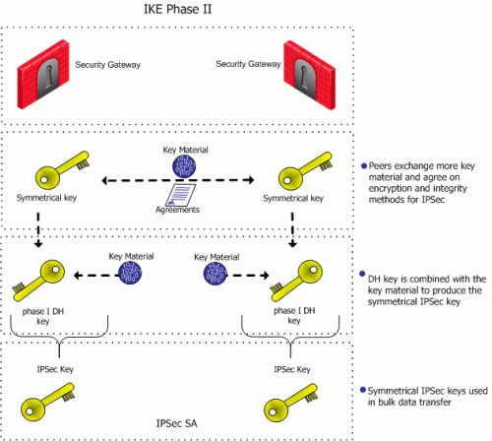
Phase 2

Slide 31
IKEv2
Significantly less complicated than IKEv1
IKEv1 sends at least 6-9 messages for setup
6 if using “aggressive” mode
9 if using “main” mode
IKEv2 sends 4 messages total
SA exchange
AUTH exchange

Slide 32
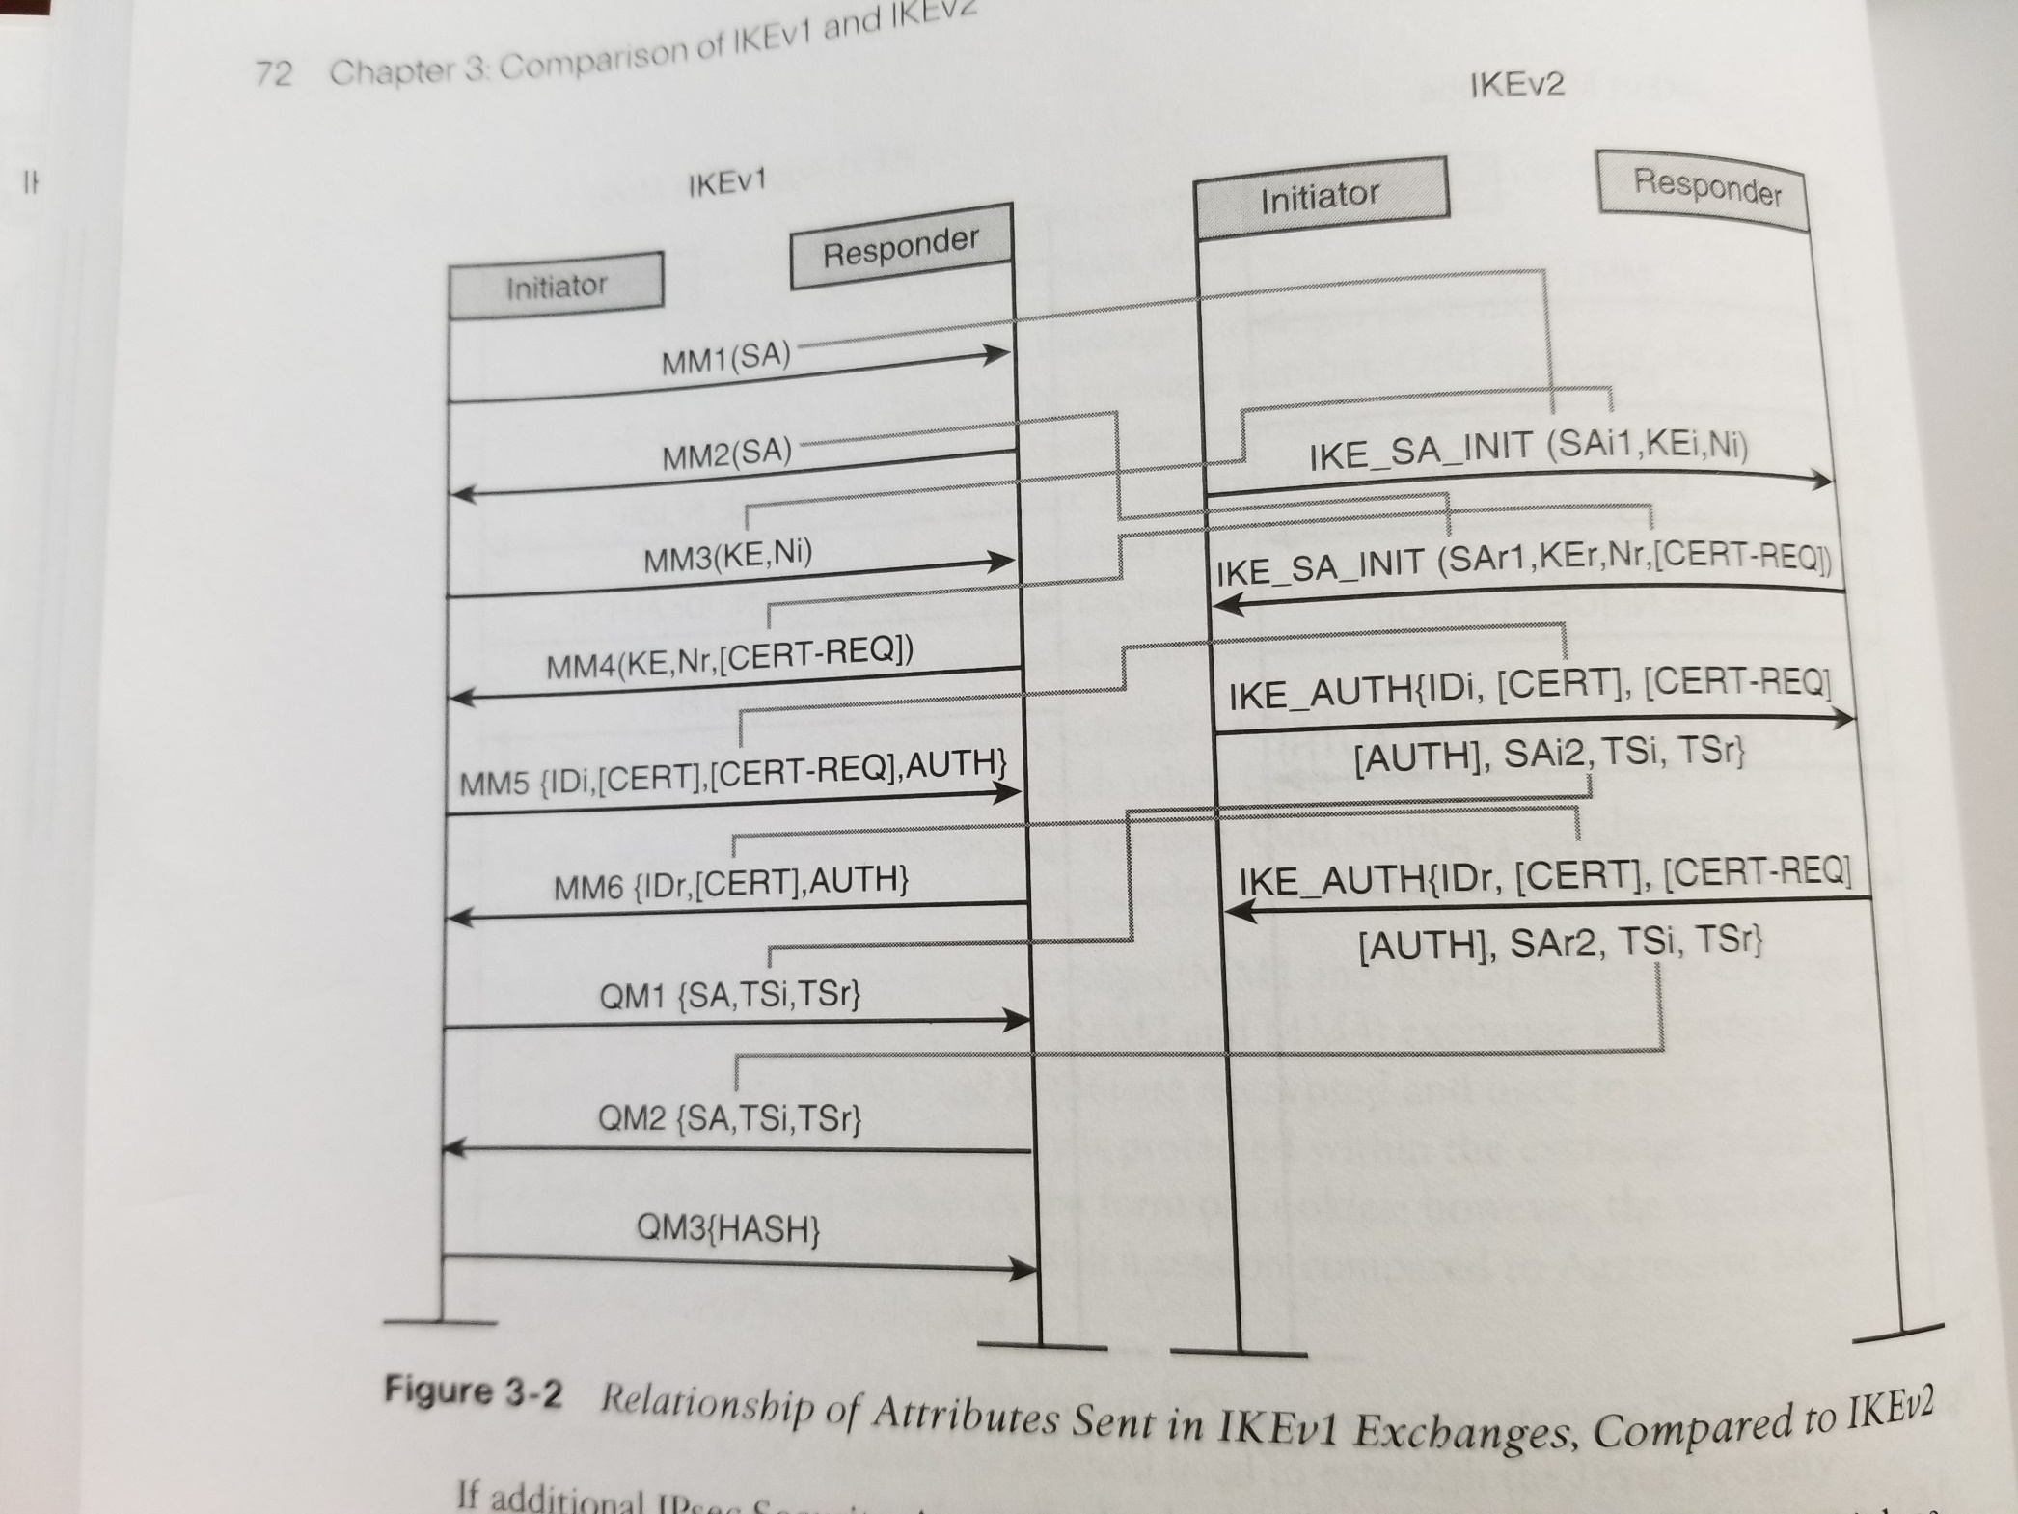

Slide 33
IKEv2 AUTH
Pre-shared Keys
Digital Signatures
EAP (Extensible Access Protocol)
ONLY FOR VALIDATING THE INITIATOR
Can
Asymmetric Authentication

Slide 34
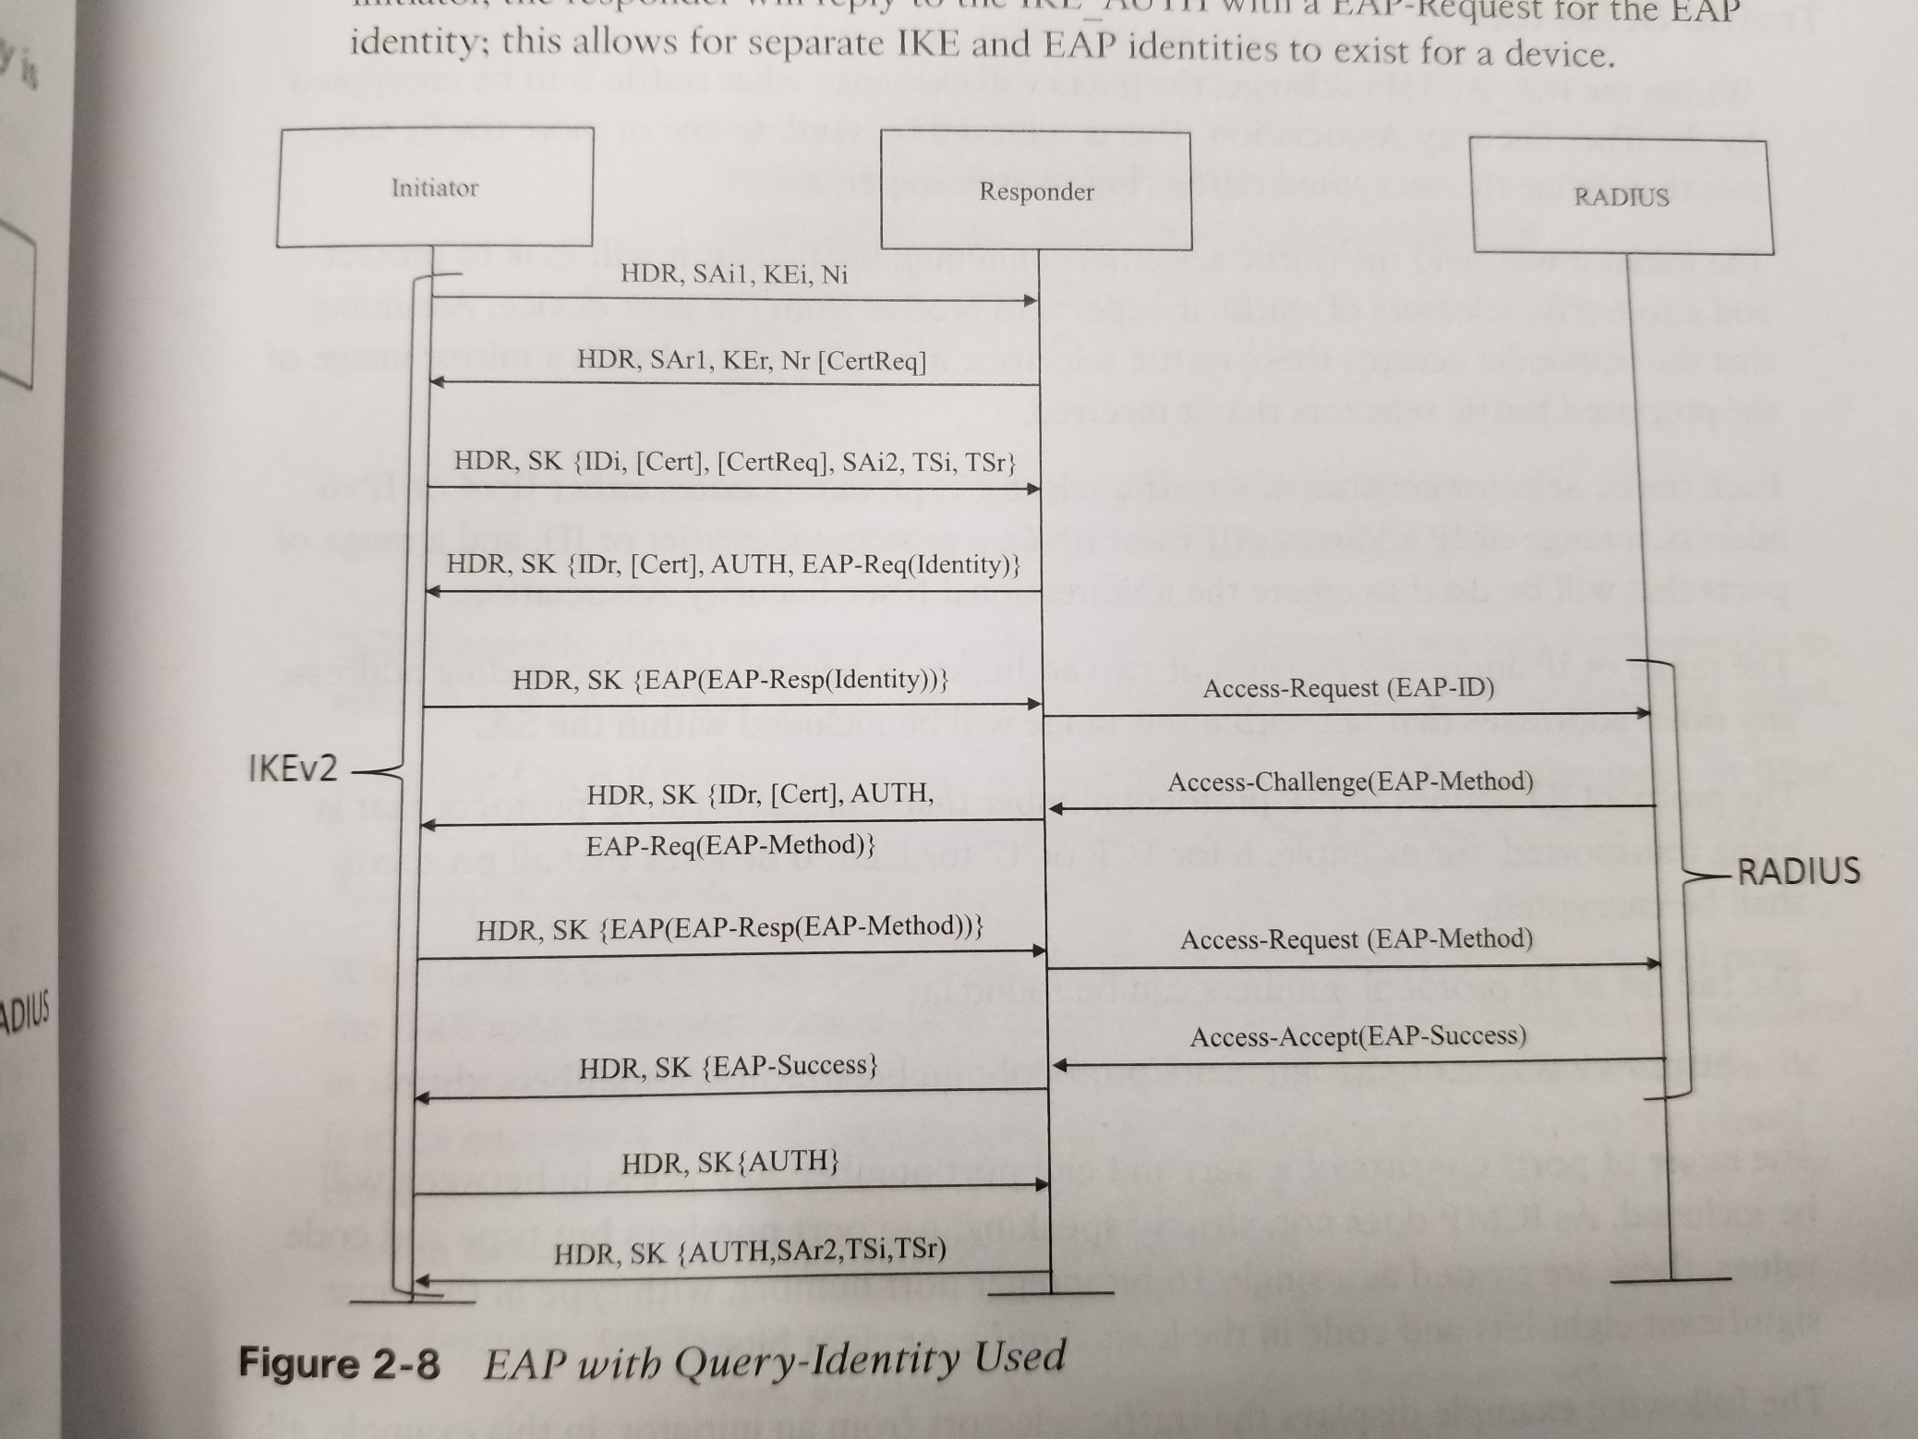

Slide 35
Additional IKE2 Benefits
High Availability
Identities + Parallel SA’s between peers
“Built-in” NAT
Mobility and Multi homing
Request-response (retry) reliability
Combined-mode Ciphers

Slide 36
Modes of Operation
Transport Mode
AH or ESP on payload of IP Packet
Tunnel Mode
Entire IP Packet is encrypted and/or authenticated
Put into a NEW IP packet (i.e., VPN tunnel)
Can use AH and ESP, but typically shouldn’t.

